Slide 1
Course Introduction
Sungjoon Choi
(sungjoon.choi@cpslab.snu.ac.kr)

Slide 2

Deep learning
RNN / LSTM
CNN
ANN
RBM

Slide 3
To tell the truth

Slide 4
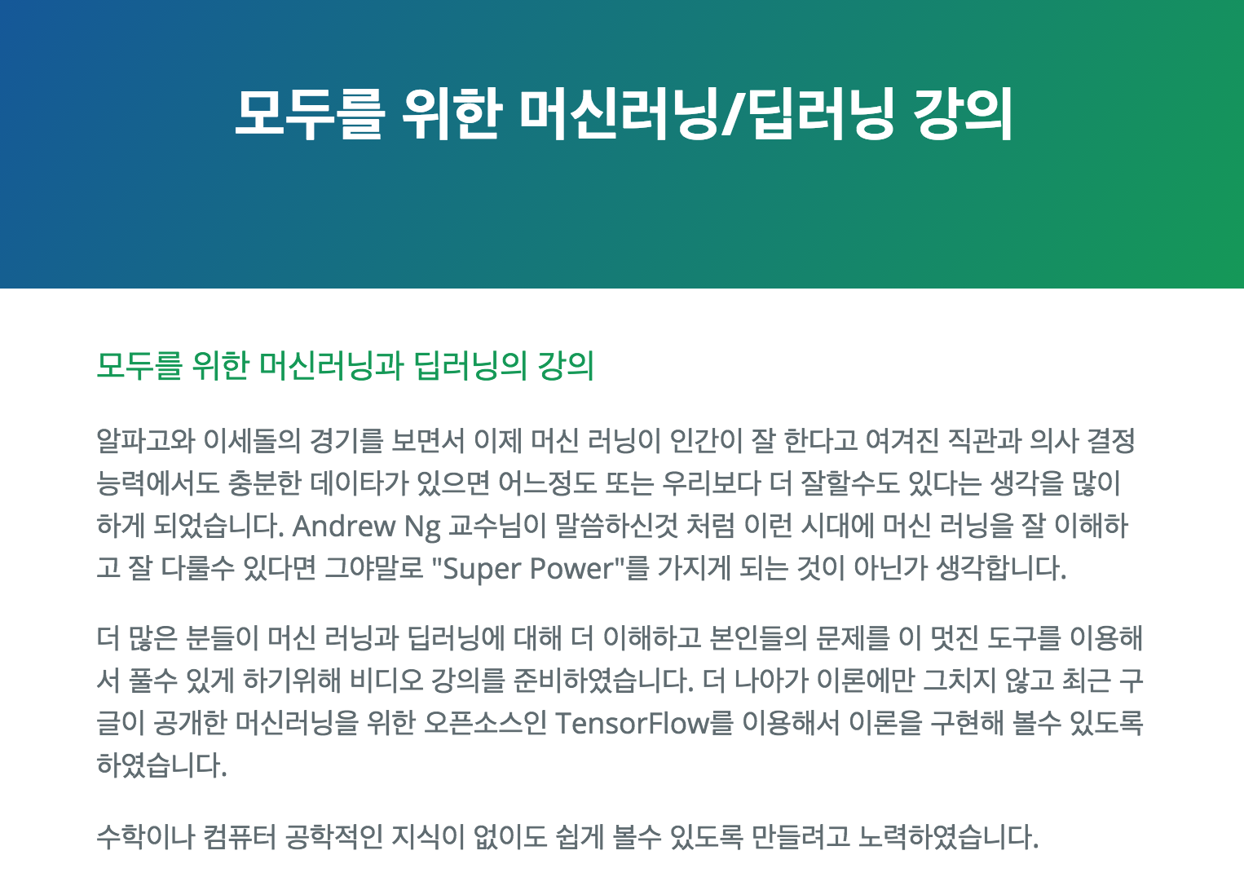
Deep learning tutorial
http://hunkim.github.io/ml/

Slide 5
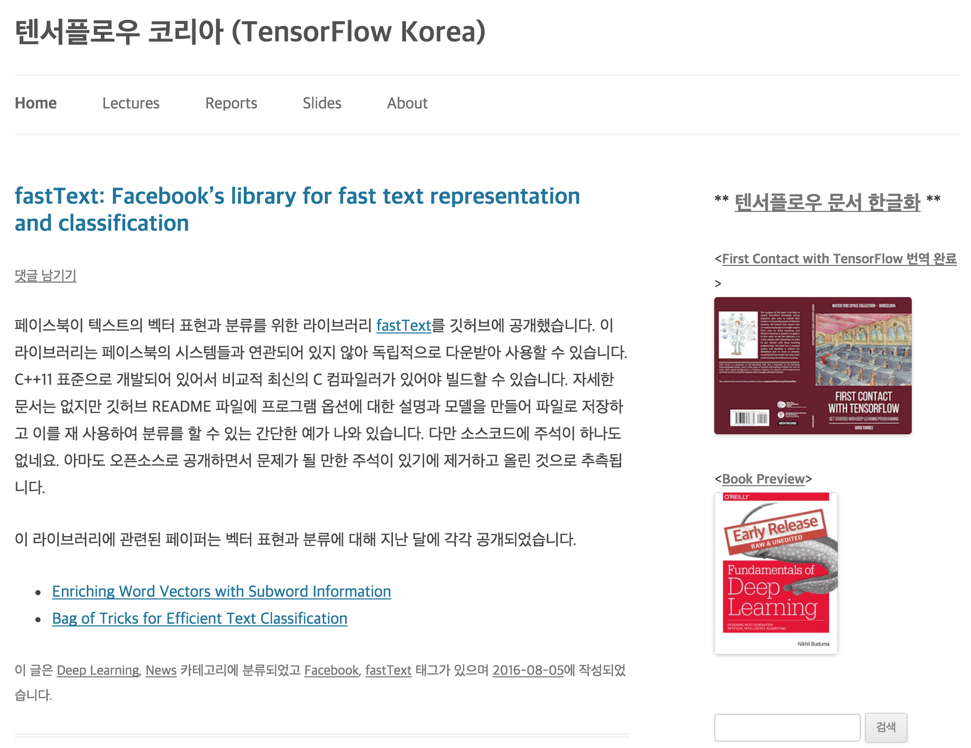
Deep learning tutorial
https://tensorflowkorea.wordpress.com

Slide 6
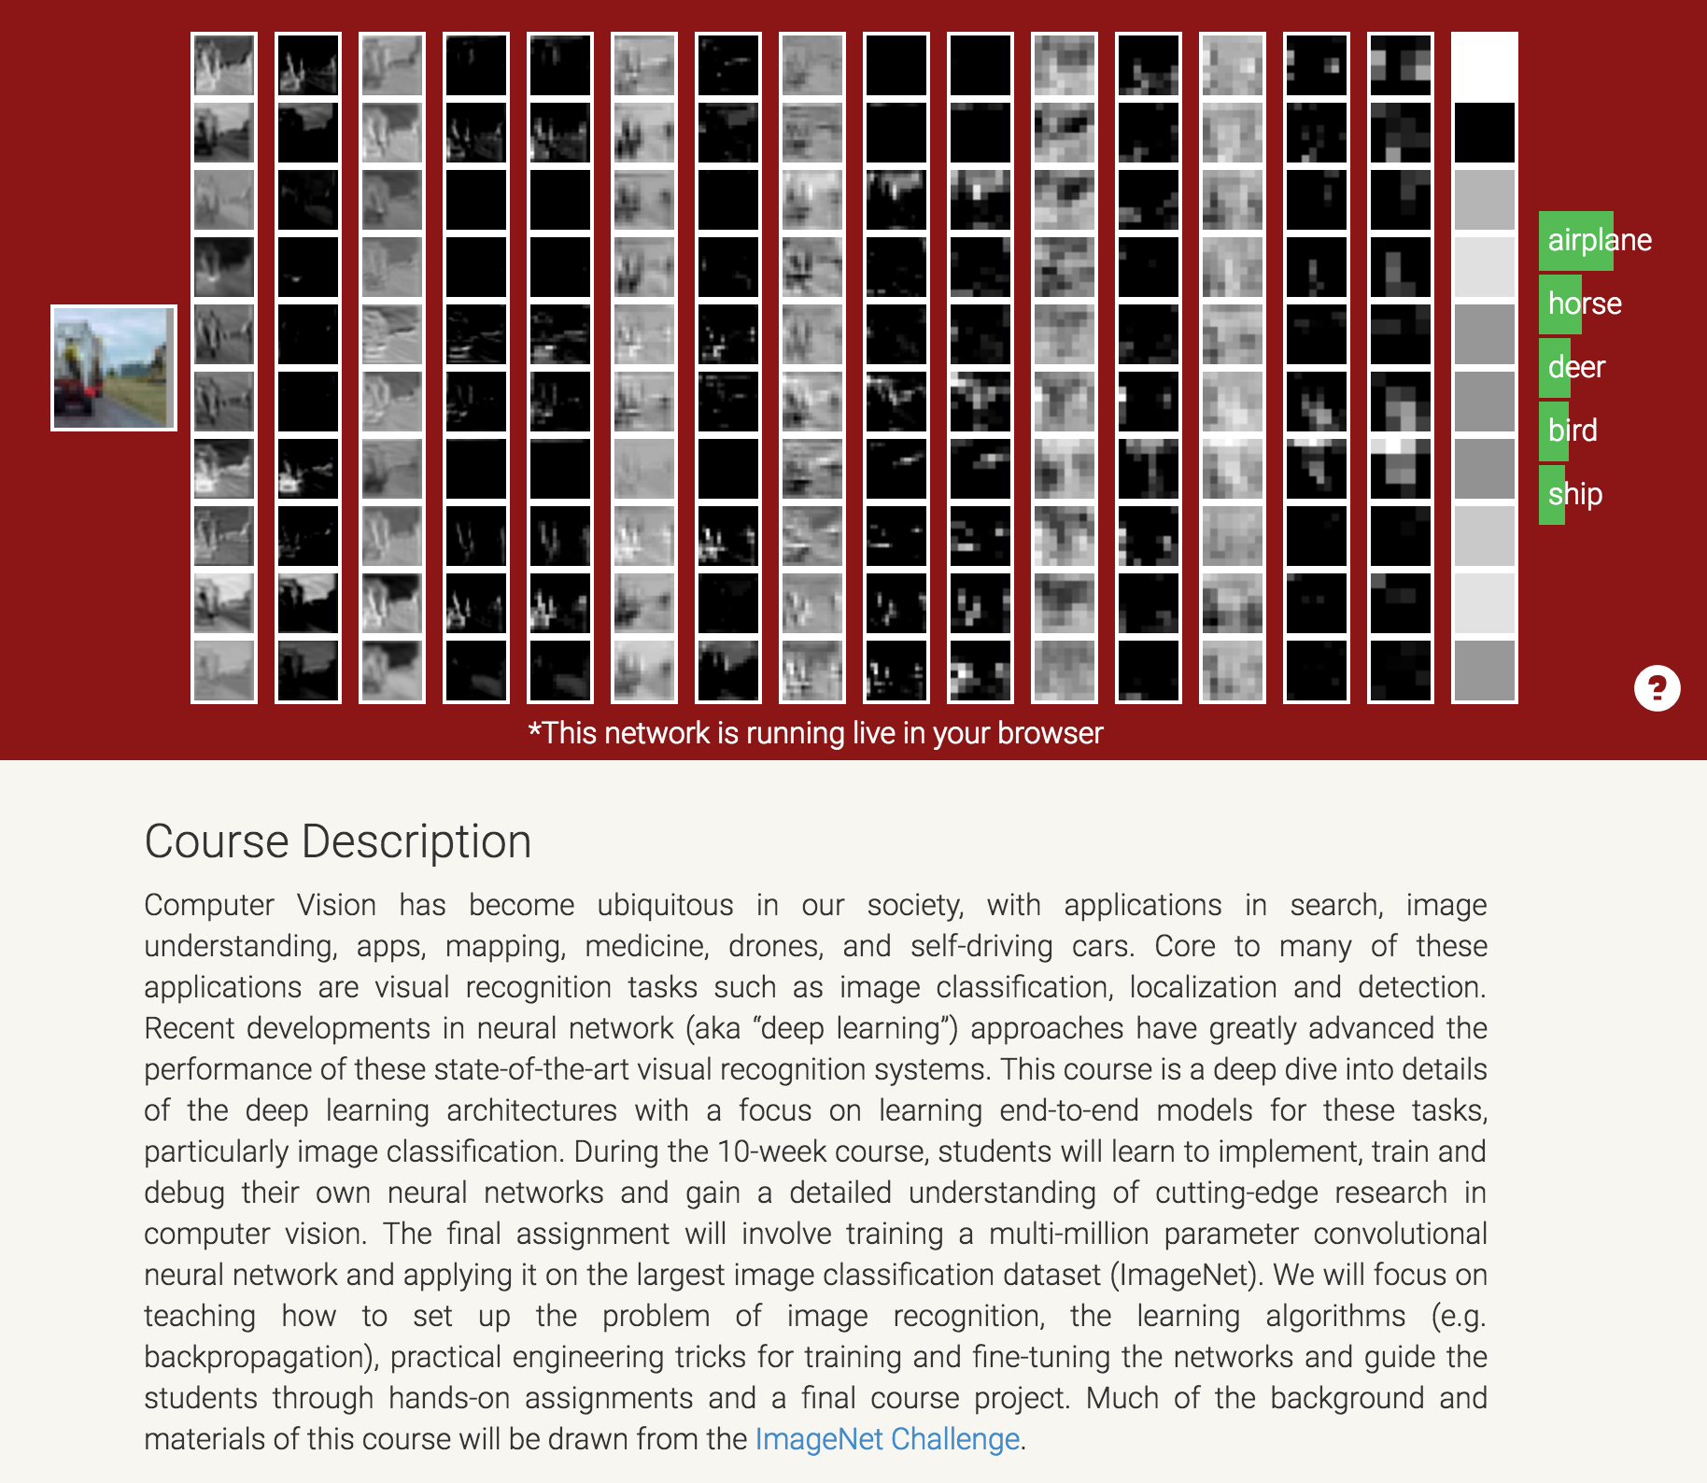
Deep learning tutorial
http://cs231n.stanford.edu/

Slide 7
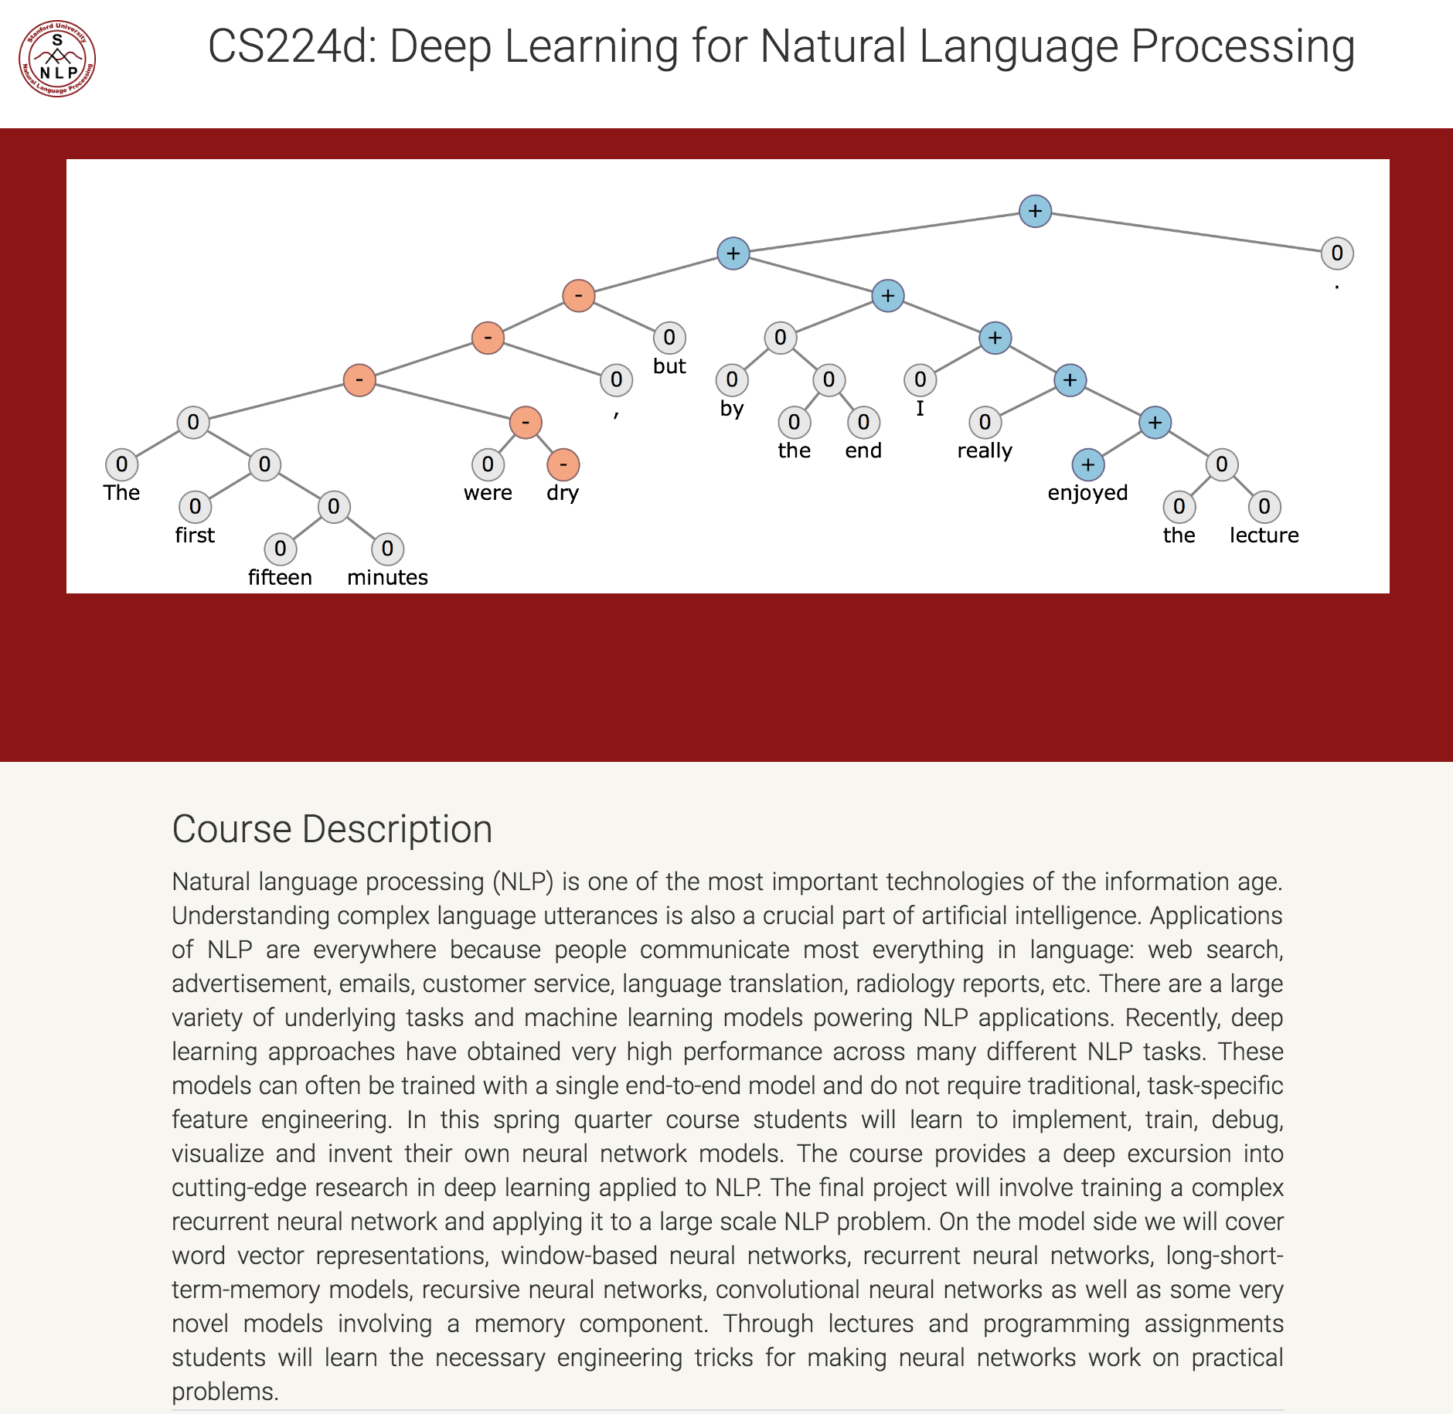
Deep learning tutorial
http://cs224d.stanford.edu/

Slide 8
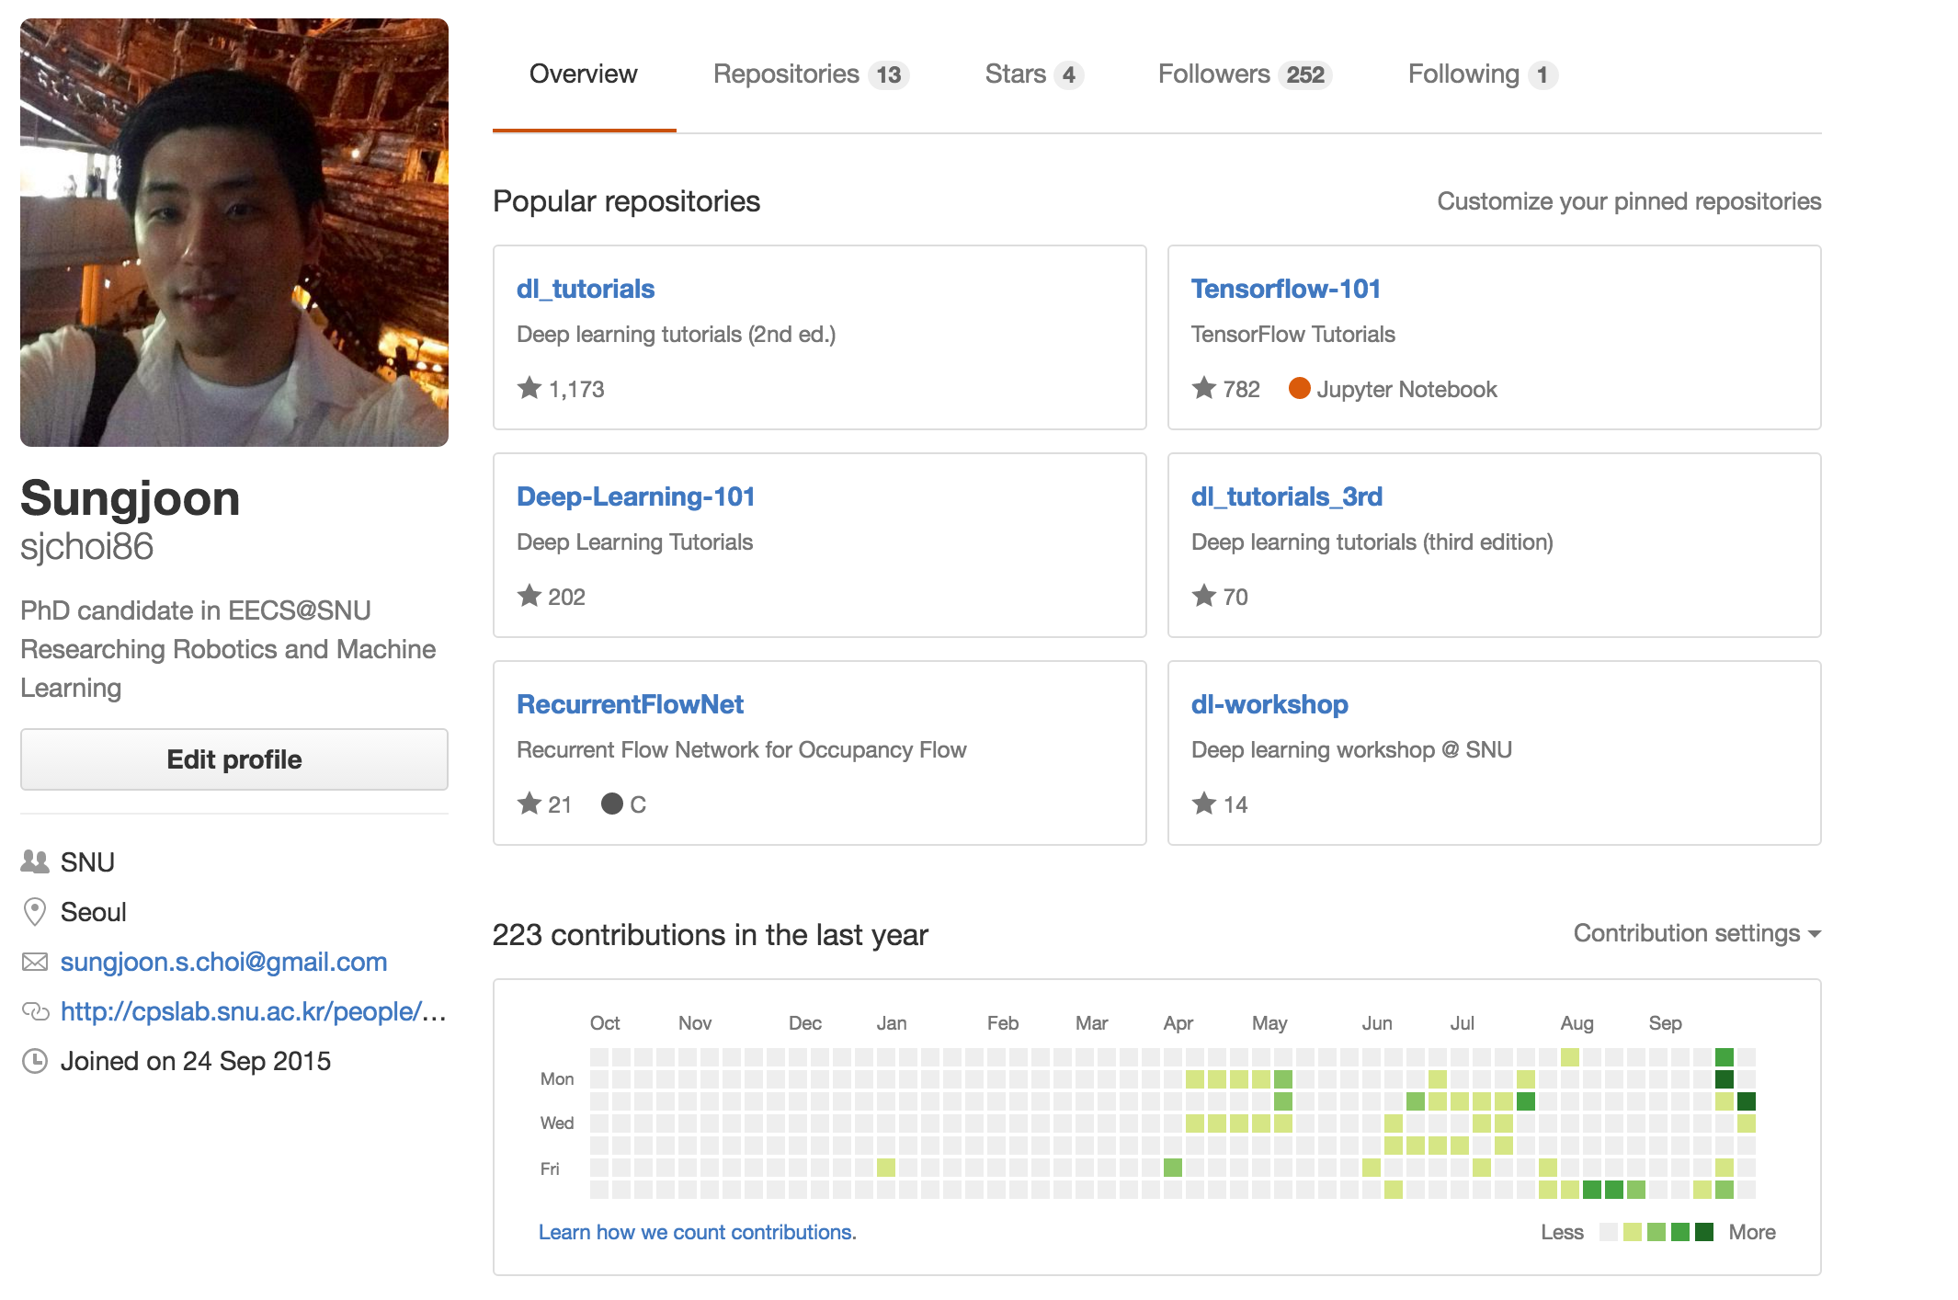
Deep learning tutorial
https://github.com/sjchoi86

Slide 9

Goal
Deep Learning
Theories
TensorFlow
Implementation

Slide 10





SNS
?

Slide 11

Be social

Slide 12
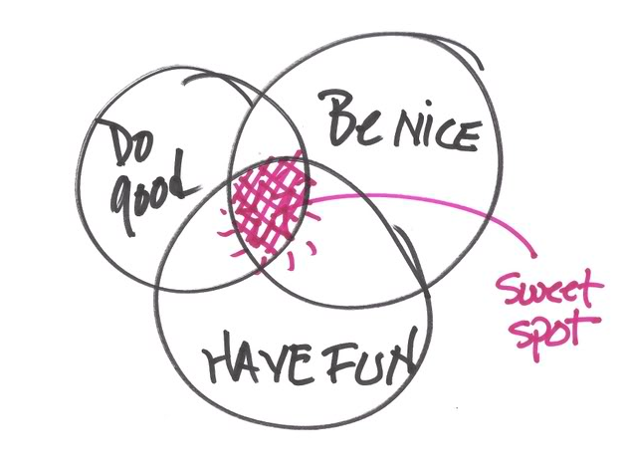
More importantly,

Slide 13

Most importantly,

